Slide 1
Business Data Management Project
Enhancing Grocery Store Inventory, Customer Retention, And Profitability
Name- Yash Srivastava
Roll Number- 21f2001569
Email- 21f2001569@ds.study.iitm.ac.in

Slide 2
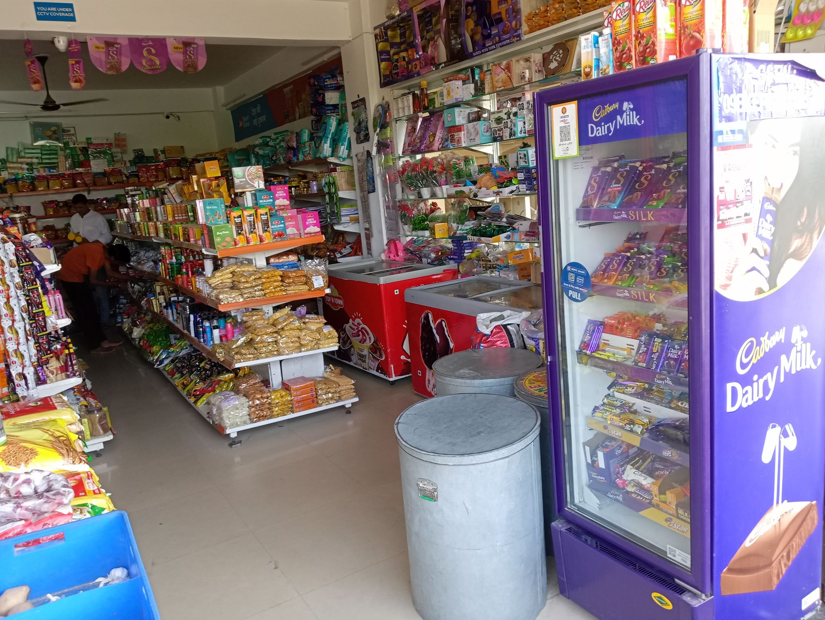
About the Business and proof of originality of data
Deepak General Store
Owner: Mr Digember Kumar Baranwal
Location: https://goo.gl/maps/Z9xD6K11f5K8cdbG7
NOC : link
Video interaction: link
There are 2 stores of Deepak General Store with 8 total employees. The old shop was founded in 2017 whereas the new one is opened few months back.

Slide 3
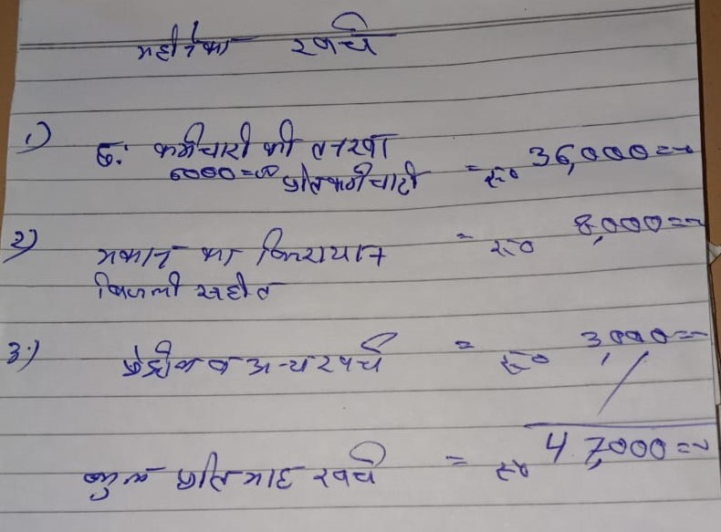
Problem Objectives
Enhance Customer Retention
Improve Inventory Management
Revenue and Profitability Growth
Tools Used for analysis: MS Excel and Python

Slide 4
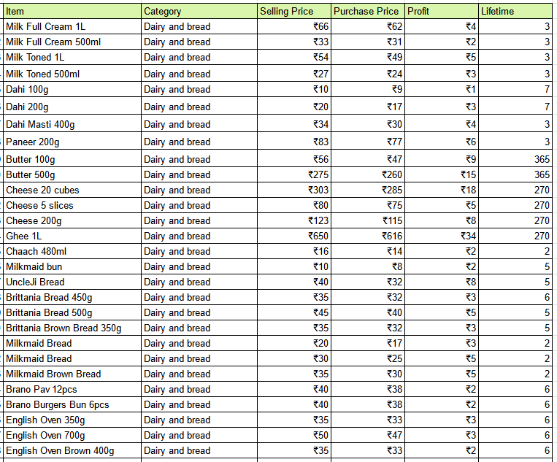
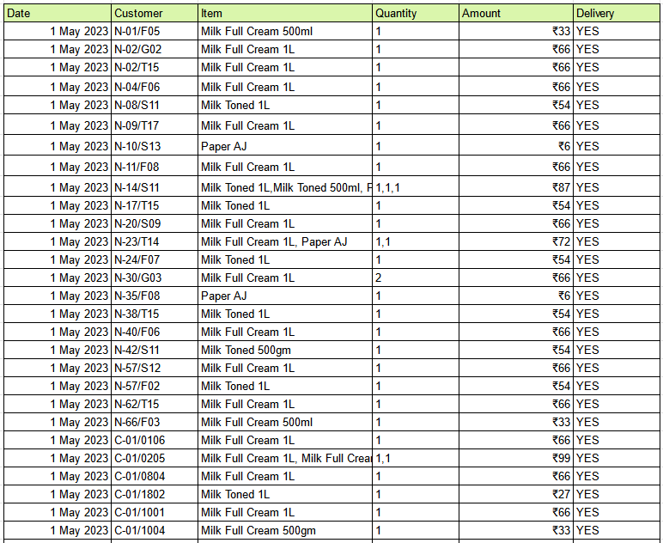
Data Collected
Pricing data
Customer Sales data
Data from May 1st 2023 to June 30th 2023 is been taken into account.

Slide 5
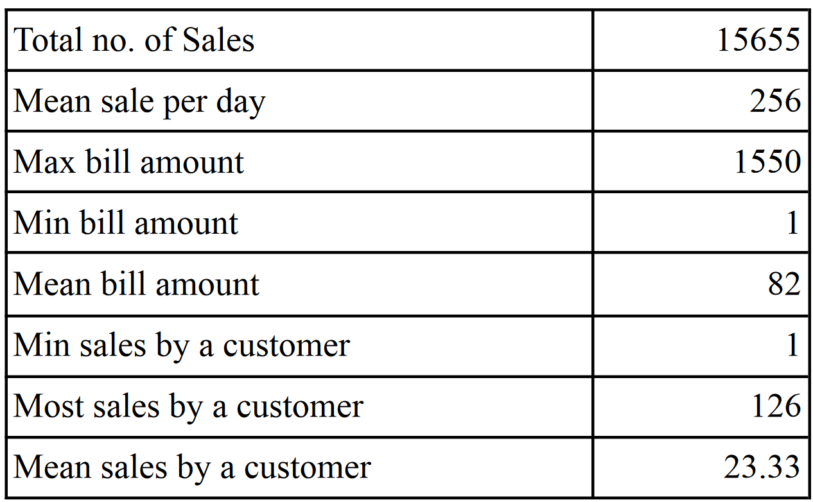
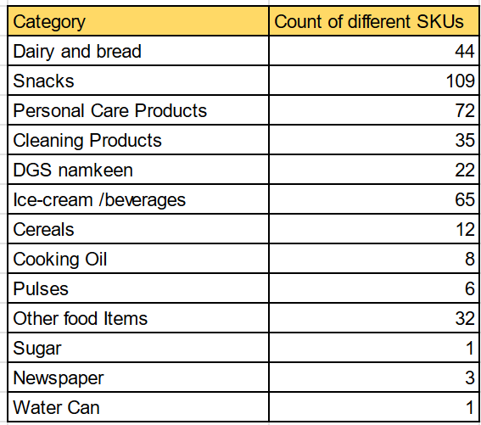
About the data
There are a total of 16746 rows in the sales data.
There are 1091 rows with ‘Amount’ equal to -1 which indicates the rejected orders which are discarded from the analysis of Customer Retention.
Out of the rest 15655, 14045 rows have non-null values for ‘Customer’ attribute.
5948 orders out of 15655 are home delivered and the rest 9707 are orders done on the shop
There are 13 different categories of products and a total 410 different SKUs in the shop.
A total of 720 unique customers visited DGS in 2 months period.
To calculate the total revenue earned, we just sum up the ‘Amount’ values which turn out to be ₹1,283,989. Whereas to find total profit, Python is used and it comes out as ₹251,119.
.

Slide 6
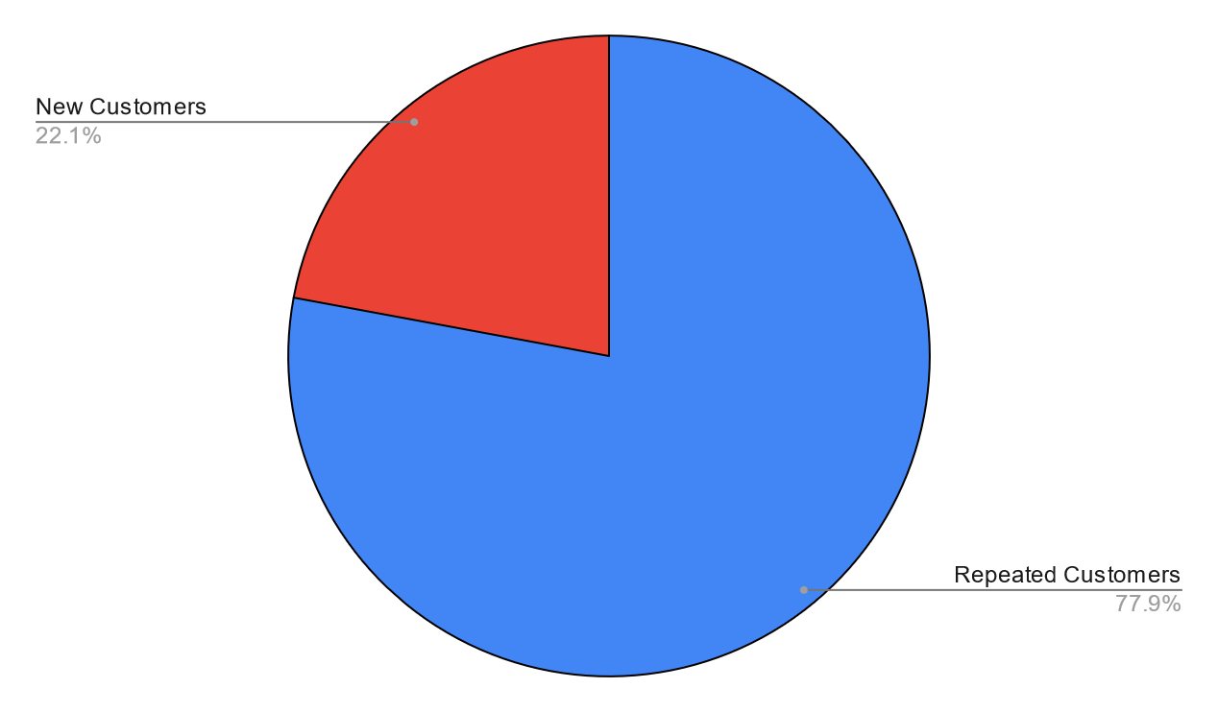
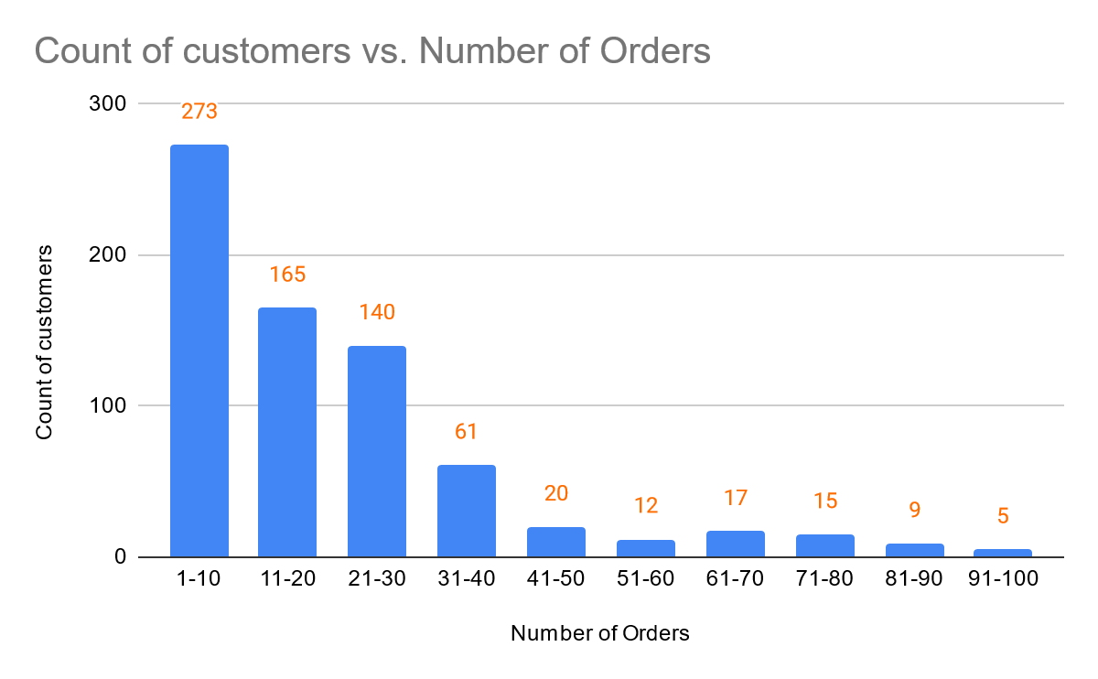
Customer Retention
In above Pie Chart, Out of the 720 unique customers 561 visited the shop at least twice and the rest 159 visited the shop only once.
Customers are divided into classes of size 10 determining the number of orders made by them to the shop. This helps us look at the customer retention better.

Slide 7
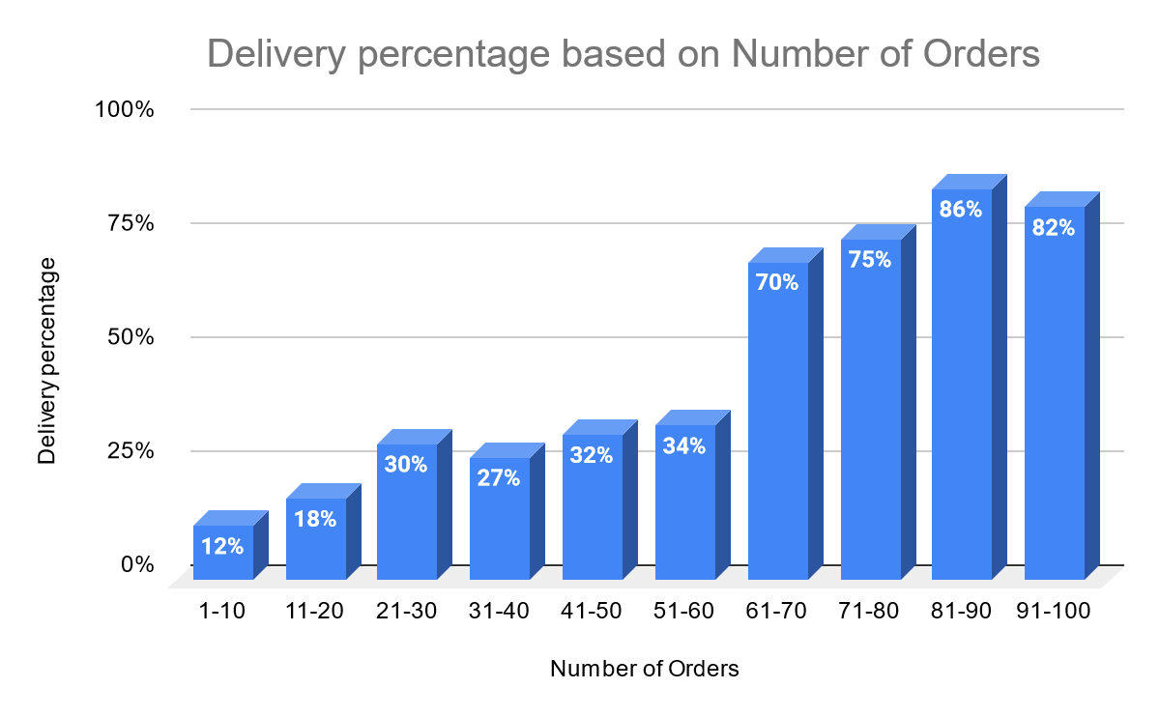
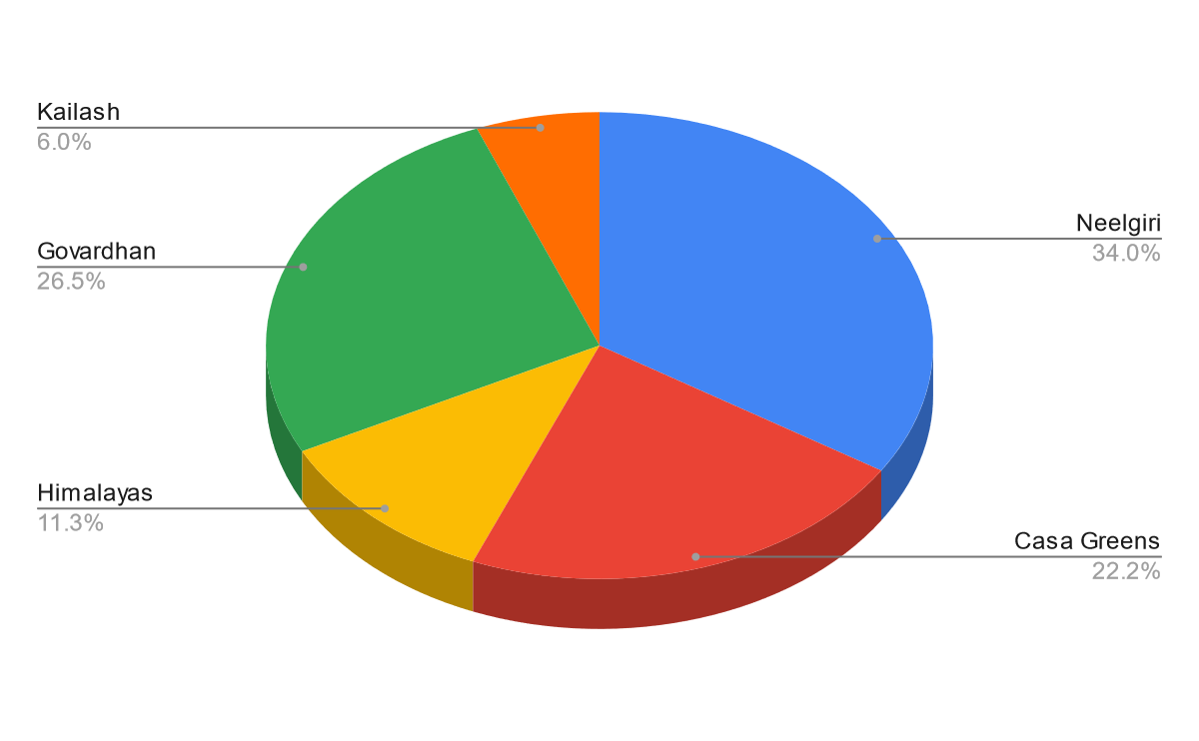
Role of ‘delivery’
There are 5 housing societies in from where the customers of DGS come from.
Percentage Contribution to the Sales from each housing society can be shown in the above Pie Chart.
Average of Percentage of delivery orders is shown for customers of each class.

Slide 8
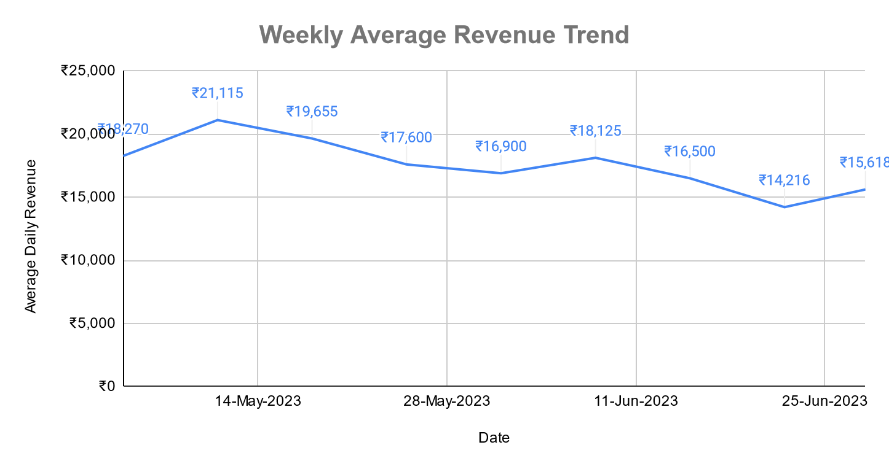
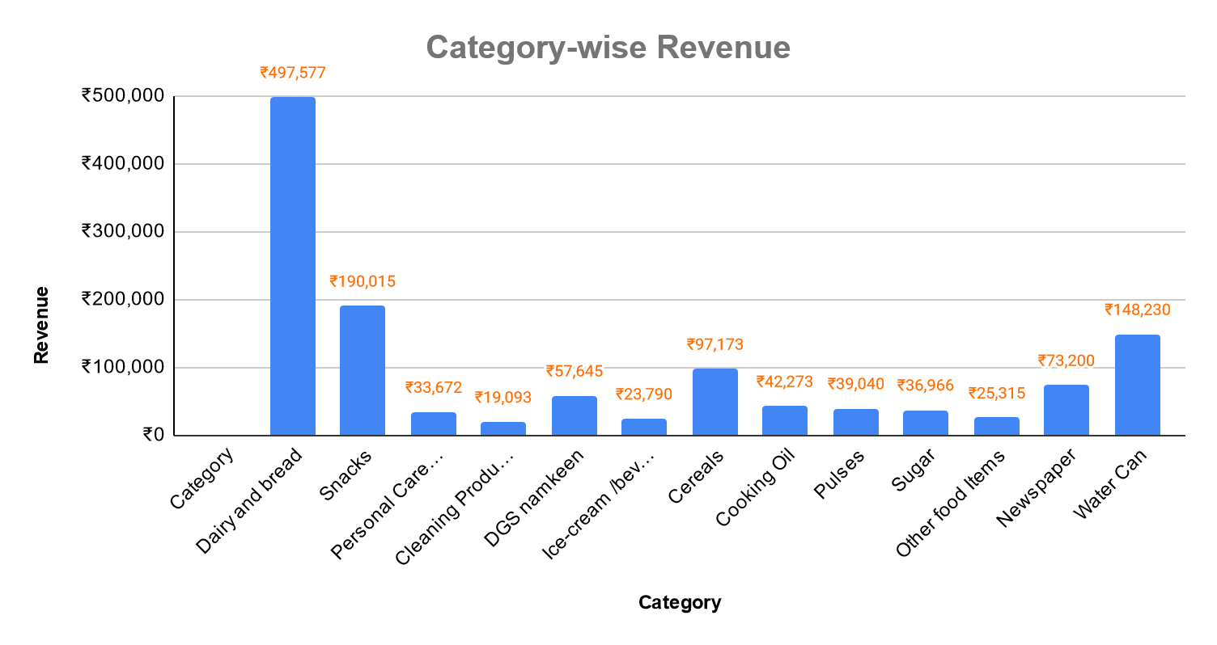
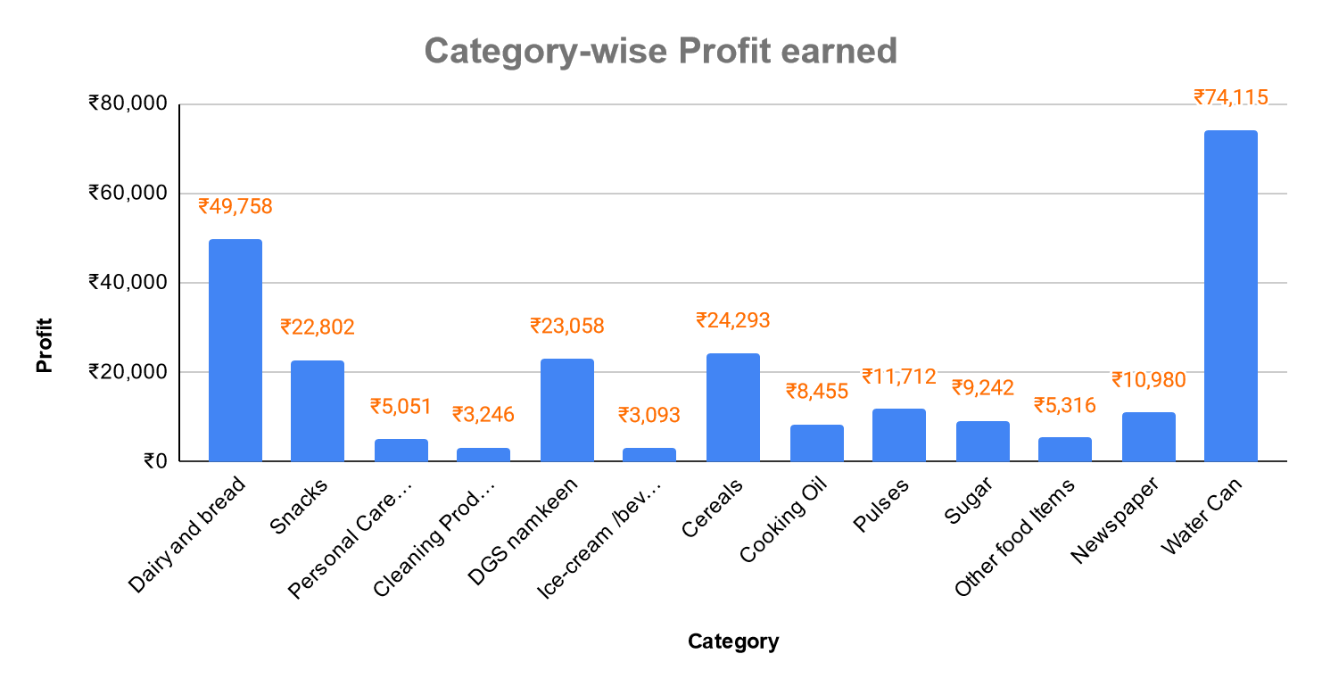
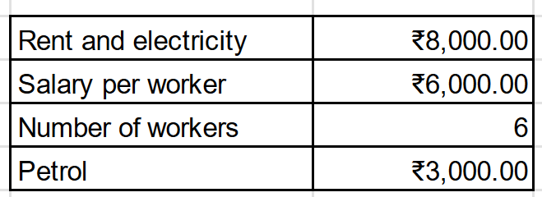
Profitability and Revenue
A total ₹47,000 is spent on the fixed costs monthly. So the net profit earned by the business in 2 months is ₹1,57,119.

Slide 9
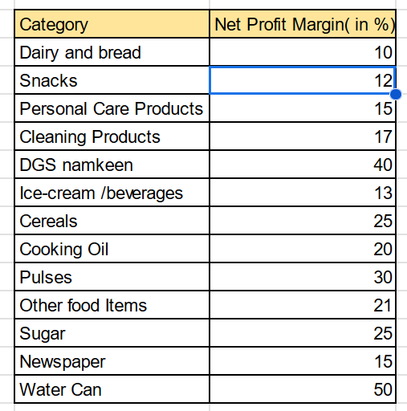
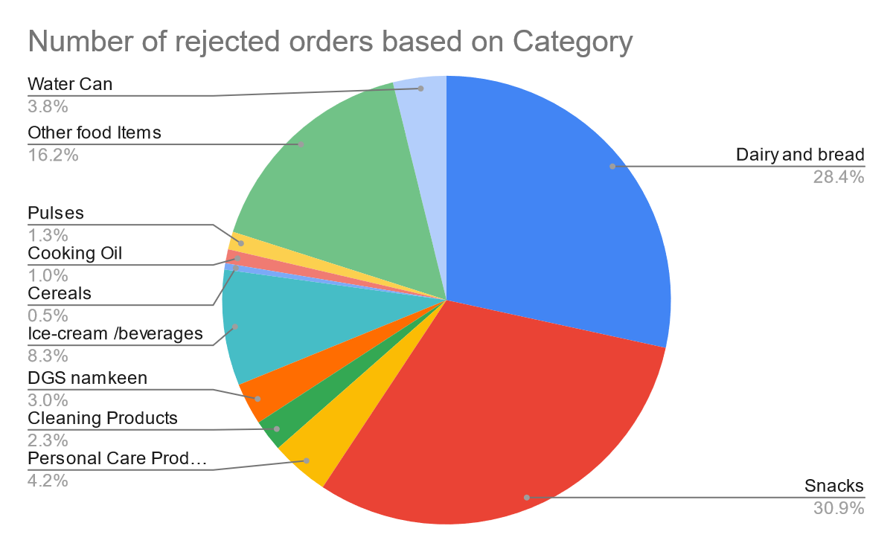
Inventory Management
From the Pricing data, we calculate the net profit margin for each category.
We calculate the number of rejected orders for each category and subsequently their percentage is shown.

Slide 10
Final Recommendations:
Avoiding stock-outs for products- For categories like Snacks stockout must be avoided as it affects not only revenue but also long term Customer loyalty.
High emphasis on free delivery- We saw the positive impact of delivery on customer retention. This will also encourage customers to prefer DGS over other delivery services and also elevate the revenue of less popular items.
Target Promotion on Housing Societies- Promotion of DGS must be done for Housing Society with less number of customers.
Promoting high-profit margin items- High profit margin products must be promoted by giving special offers and different marketing techniques.
Better data storing technique.
Thank You !

